Slide 1
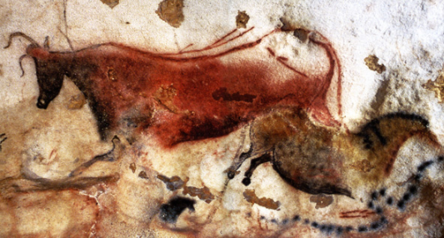
Hominin Cultural Evolution
Cultural Evolution

Slide 2
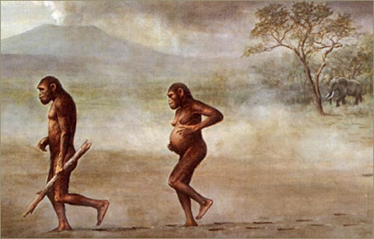

Introduction
In addition to anatomical and physiological evolution, hominins have developed complex cultures that allow them to survive better in their environment.
Bipedalism came first, followed by brain size, which in turn led to innovation and adaptation through abstract thought and problem solving.
Cultural evolution can be seen in:
Tool and technology development
Development of methods for obtaining food
Increasing sophistication of language
Other changes including symbolic representation (eg visual art)

Slide 3
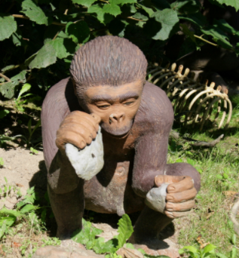
Cultural Evolution – Australopithecus
Brain size and evidence of diet show likely to have culture and lifestyle similar to chimps but adapted to grassland.
Had home bases: lived in one place, left from there to forage for food
No evidence that they built shelters
No evidence of fire use or cooking
No evidence of language – likely similar communication to chimps
No evidence of art
No evidence of abstract or symbolic thought
No evidence of hunting; primarily foraged, plant-based diet.
Tools
Used rocks and sticks as tools, for example to break hard-shelled fruits and seeds.
May have made primitive stone tools (eg Oldowan tools) but experts are divided on this – not enough evidence. In a short answer question asking about use of Oldowan tools, say that Australopithecus may have used them, and H. habilis definitely did.

Slide 4
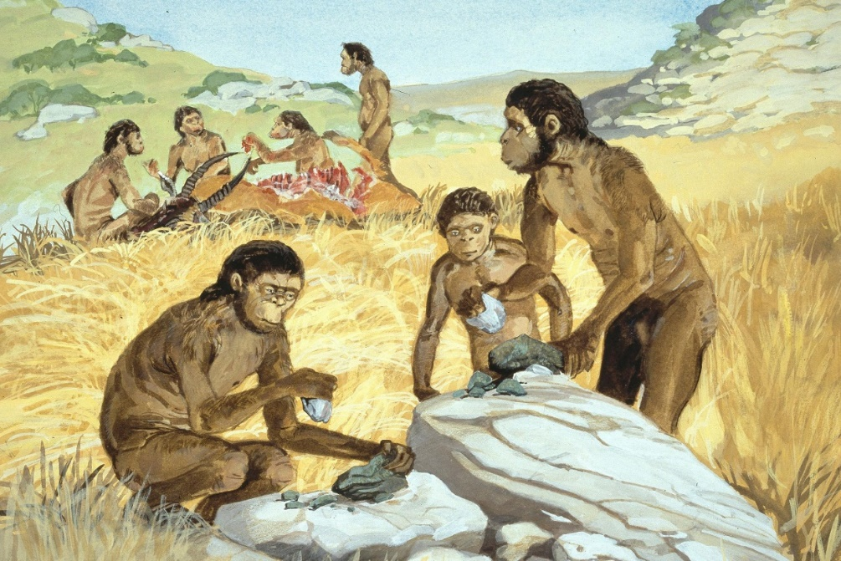
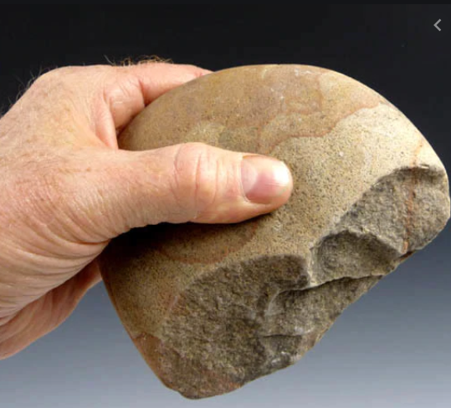
Cultural Evolution - Homo habilis
Larger brains than Australopithecines
Needed more complex fats and higher levels of protein – brains use energy!
Therefore needed to consume meat
May have had some simple language development – not a lot of evidence
Home bases – left to forage for plant food and scavenge animal remains
No evidence of built shelters
No evidence of fire use
No evidence of art
No evidence of abstract or symbolic thought
Tool Use – Oldowan Tool Culture
Made and used this tool type
Range of pebble tools found: choppers, scrapers, flakers, chisels
Require precision grip
Used tools to extract marrow from animal bones
Tool use enabled colonisation of a broader range of habitats
May have been the first to make these tools (some experts say Australopithecus were first to make them.)

Slide 5
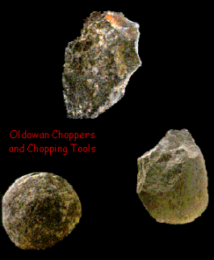
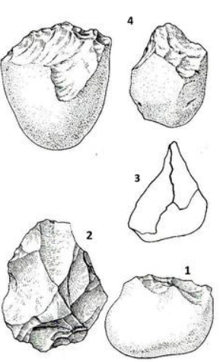
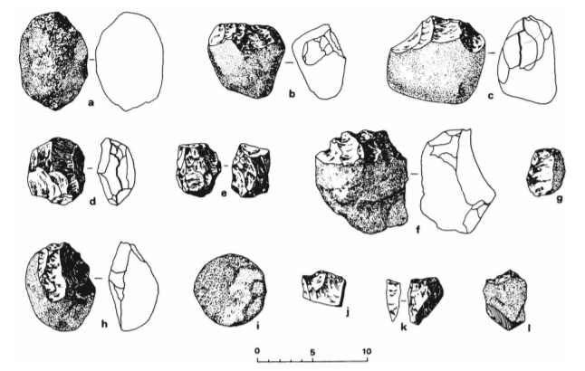
Cultural Evolution - Homo habilis – Features of Oldowan tools
Large tools – size of hand
Rough flaking, chips bashed off to make sharp edge.
Generalised tools for hitting things until they break. Not developed for specific purpose (no arrowheads, fish hooks, blades etc)

Slide 6
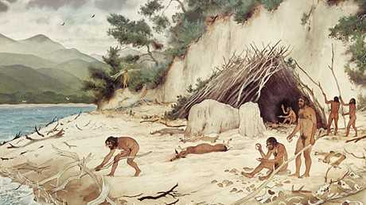
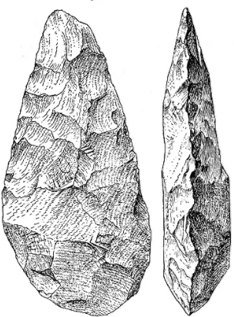
Cultural Evolution - Homo erectus
Further increase in brain size and development
Began to modify environment to suit own purposes
Home bases:
Built shelters to protect from the elements
Terra Amata: site dating to 400 000 years ago
Wood huts
Evidence of fire use
Tools from stone
Remnants of animal bone from hunting - also fish bones – fishing?
Evidence that H.erectus used fire:
Kept predators away
Warmth and light
Used during hunting to drive animals
Cooking of food
Tools
Flaked around all edges, teardrop shaped “hand axes”
Referred to as Acheulean tools (from where they were first discovered)
Only appeared to make this one type of tool, and possibly wooden spears

Slide 7
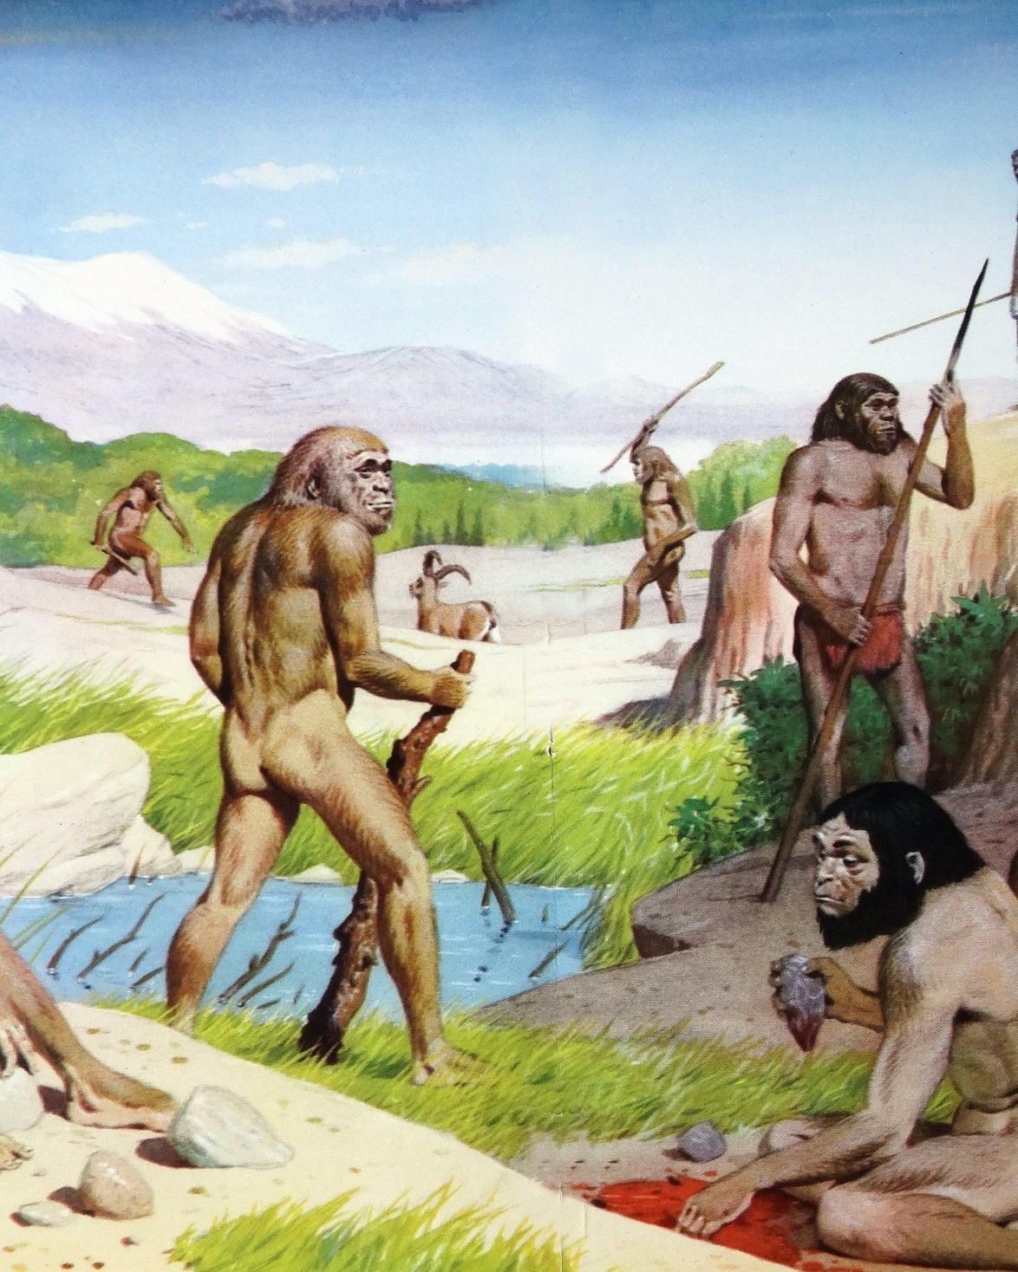
Cultural Evolution – Homo erectus
Food:
Hunter- gatherer society – collaboration and cooperation
Most food from gathering, supplemented by hunting
Skilful, strategic hunters
Evidence of planning – planned baboon slaughter miles away from base
Drove elephants into swamps using fire, then butchered them
Sophisticated, systematic butchering using tools
Women used complex techniques and collaboration to gather food.
Balanced with child rearing
Social organisation
A result of hunting/gathering/use of tools and fire.
Complex society, shared care, food sharing.
Relatively complex social language may have developed.

Slide 8
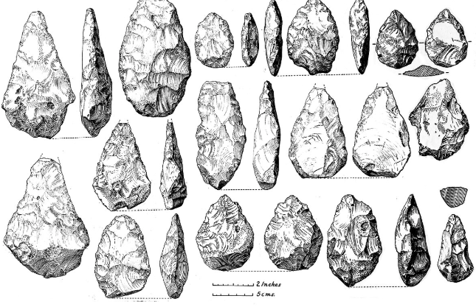
Acheulean tools – Homo erectus
Cultural Evolution - Homo erectus – Features of Acheulean tools
Large – hand sized
Rough tear-drop shape
Not a lot of variation
General rather than specific use
Finer flaking than Oldowan
Bifacial – thin axe-like edges with two broader faces.

Slide 9
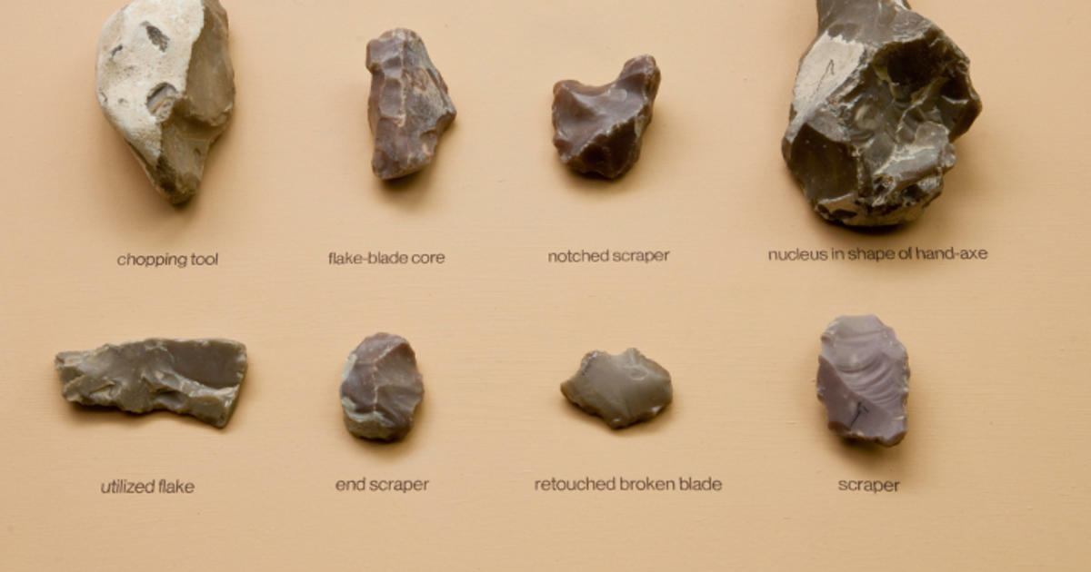
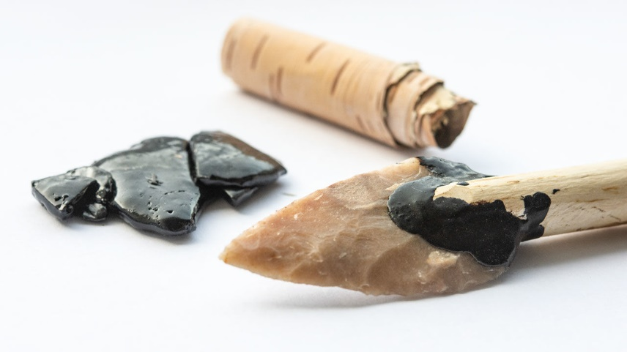
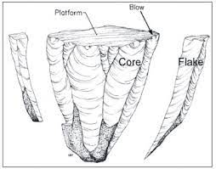
Cultural Evolution: Homo neanderthalensis
Specialised hunters
Meat an important part of diet
Plant food sources scarce in ice-bound Europe
Needed energy from animal fats to survive the cold
Made sophisticated stone tools
“Mousterian Industry”
Flaked a range of tool types from stone cores – many tools from a single core
Hafted (stuck) stone tools to wood to make axes, spears.
Made stone scrapers to scrape hides, then pierced them with sharp tools and bound them together with strips of hide to make clothing.
Previous hominins made simple, generalised tools and did not use the core and flaking technique to make many different tools from a single stone
Made clothing
Likely to have lived in caves
Could make and use fire for hunting, cooking and warmth
Buried dead, cared for sick and injured
No evidence of abstract thought or symbolic representation eg cave art.

Slide 10
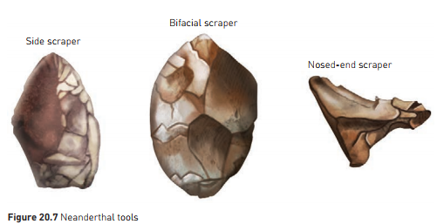
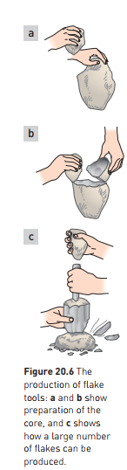
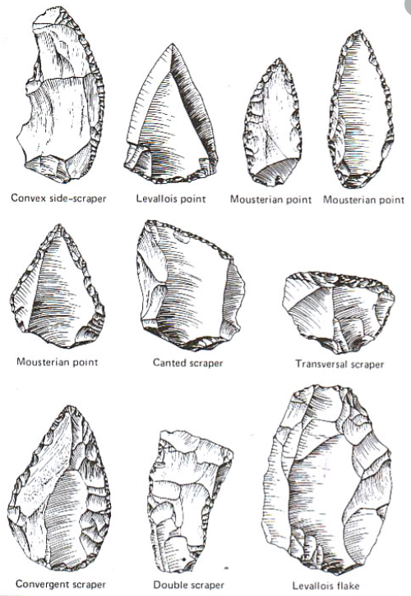
Cultural Evolution – Homo neanderthalensis – Tools
Variety of tool shapes and sizes to suit different purposes eg scraping, stabbing, piercing
Relatively fine flaking to edges for sharpness
Points would have been hafted to wood for use as spears

Slide 11
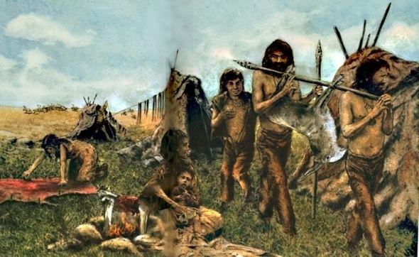
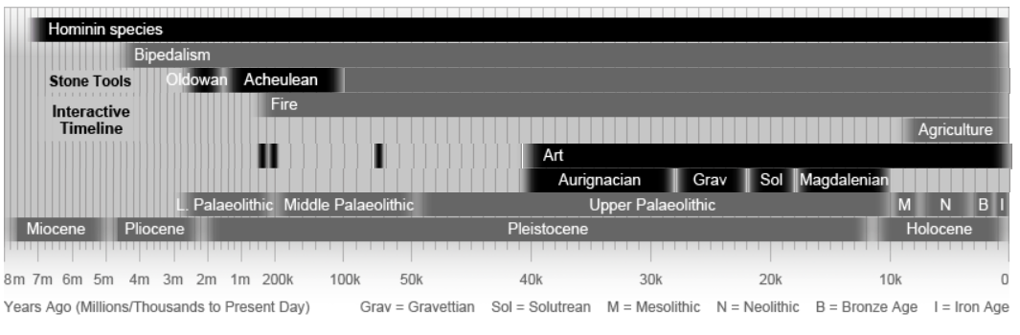
Cultural Evolution – Homo sapiens – middle Palaeolithic
Evolutionary transition between H. heidelbergensis and H. sapiens 300 000 – 100 000 years BP
By 100 000 years BP: Early Homo sapiens – middle Palaeolithic
Anatomically identical to modern humans
Behaviourally not yet modern
Hunter-gatherer societies
Used fire
Made sophisticated tools
Hunted and butchered animals
Made clothes
Had language
Made shelters

Slide 12
Cultural Evolution – Homo sapiens - upper Palaeolithic
40 000 years – 10 000 years BP – “Cro-Magnon Man”
Acceleration in technological development and migration
Hunter-gatherer societies
Used fire
Made sophisticated tools
Hunted and butchered animals
Made clothes
Had language
Made shelters
Stone tools, hunting and butchering techniques, art and social structures increased in complexity.
3 main Cro Magnon cultures we look at in Human Biology:
Aurignacian (40 000 – 28 000 BP)
Solutrean (21 000 – 17 000 BP)
Magdelanian (17 000 – 12 000 BP)

Slide 13
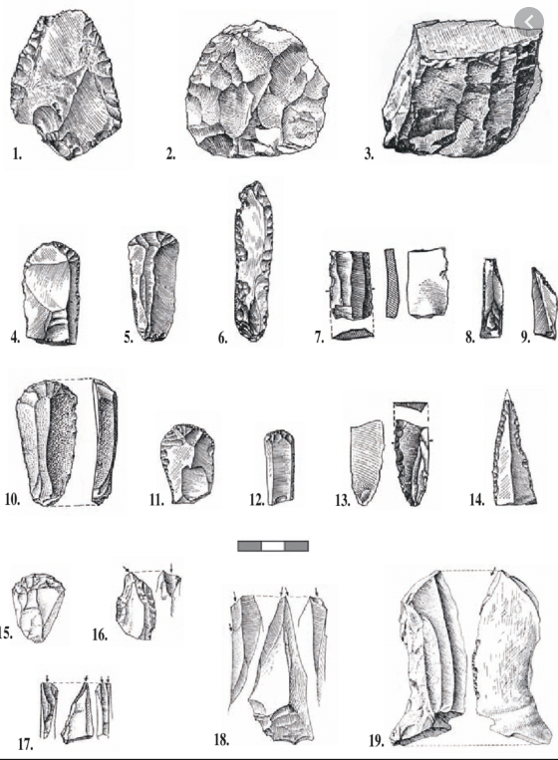
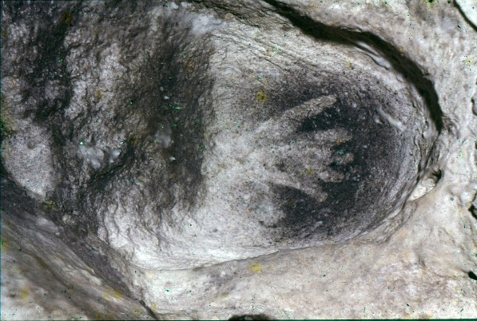
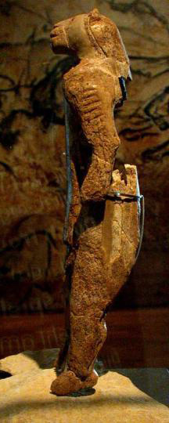
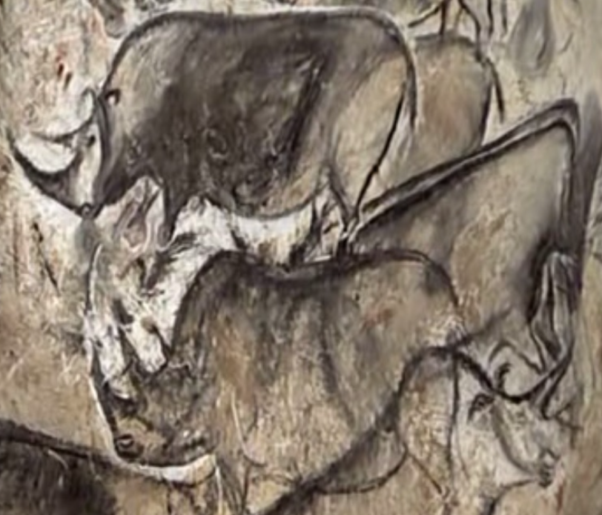
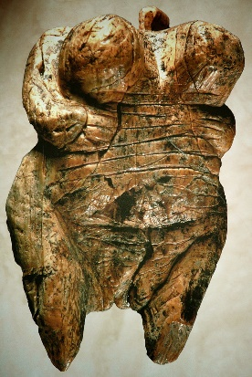
Cultural Evolution – Homo sapiens - Aurignacian 40K – 28K BP
Aurignacian tools:
Stone blade tools, made from flakes off large stone core, then finely shaped
Fine flaking
Variety or sizes, shapes and uses
Aurignacian art

Slide 14
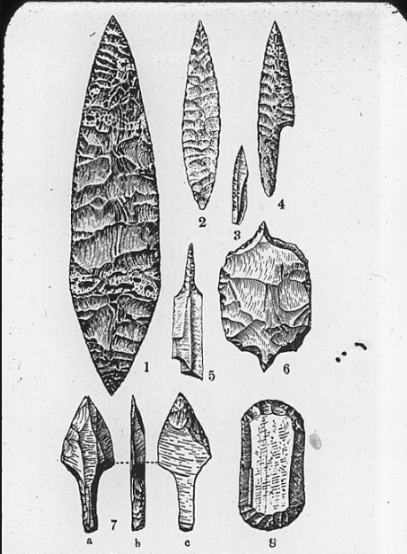
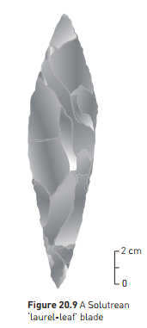
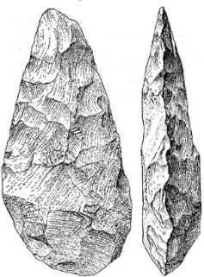
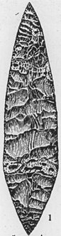
Cultural Evolution – Homo sapiens - Solutrean 21K – 17K BP
Solutrean Tools
Very fine pressure flaking
Leaf-shaped blades
Symbolic blades
Some students get confused between the much older Acheulean hand axes used by H. erectus, and Solutrean leaf shaped blades. Solutrean blades have MUCH finer flaking, and are pointed at both ends.

Slide 15
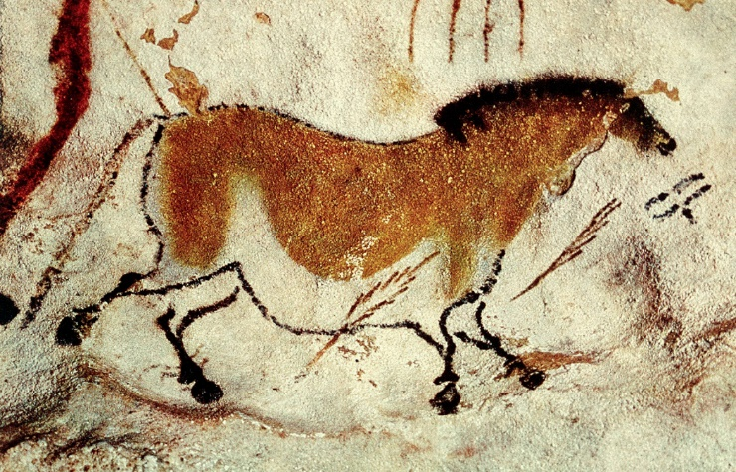
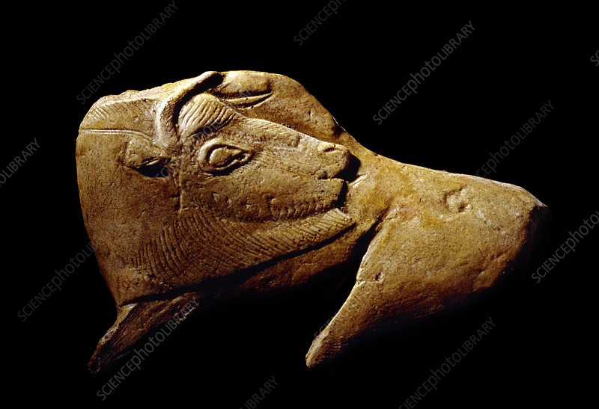
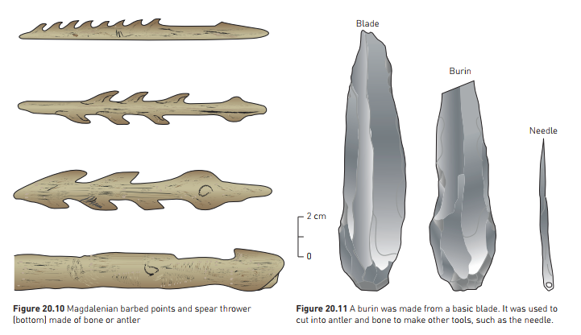
Cultural Evolution – Homo sapiens - Magdelanian 17K – 12K BP
Magdelanian Tools
Bone and antler tools predominated
Barbed spears
Spear throwers
needles
Tool for making other tools – a stone “burin” chisel used for carving bone and antler
Art
Art works
Portable – carved figurines
Mural art on cave walls
Use of colour and shading

Slide 16
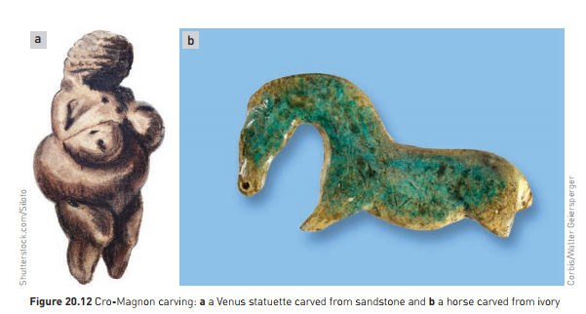

Slide 17
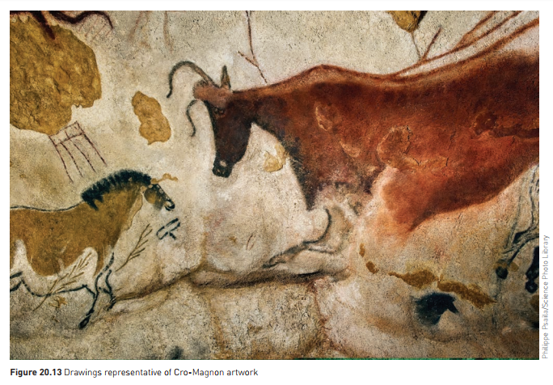

Slide 18
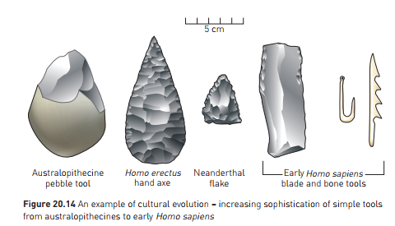
Note – as the tools become more modern, there is:
Finer flaking
Greater variety in shape and size
Greater specialisation (eg blades, needles, spearheads etc)

Slide 19
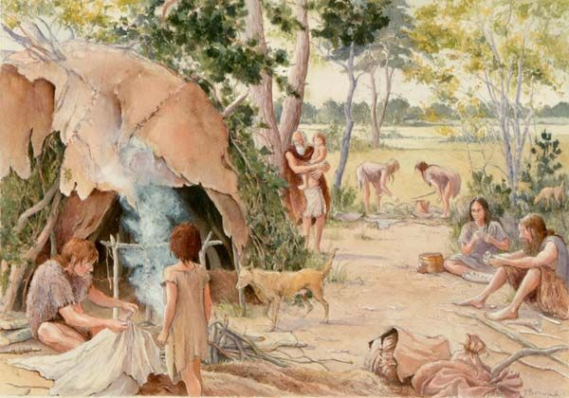
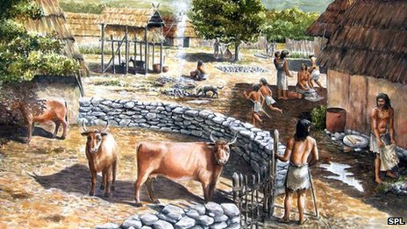
Cultural Evolution – Homo sapiens - Mesolithic and Neolithic
Big step in human history
Change from nomadic to village lifestyle
“Neolithic revolution”
Domestication of plant and animal species
Likely to have begun in South-West Asia, around Palestine
“Fertile Crescent”
12 500 years ago
Gathered wild grasses, which hybridised
Fertile hybrid: “Emmer”
Later hybrid; large grains, good for making flour, but could no longer by scattered by wind; had to be sown – agriculture!
Allowed easier gathering of resources and freed up time and energy for thinking, planning and innovation.

Slide 20
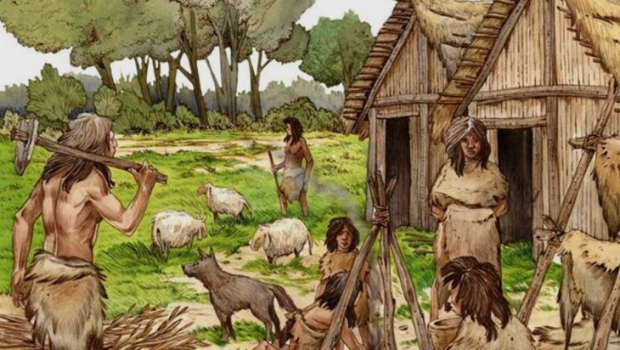
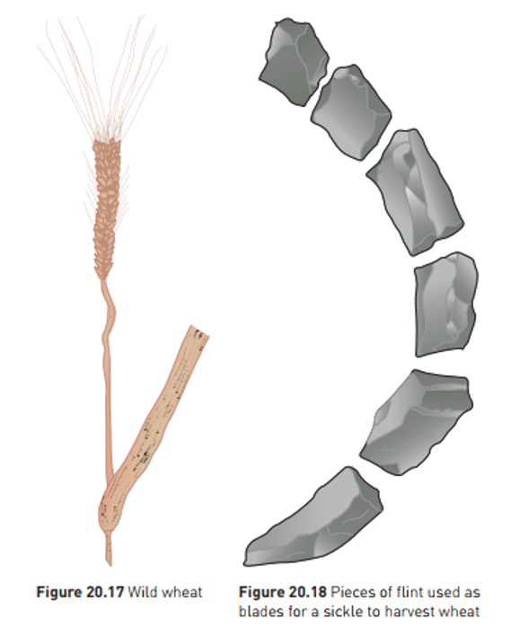
Cultural Evolution – Homo sapiens - Beginning of Agriculture
Domestication of crops occurred independently at different sites around the world:
China – rice, millet, soybeans, yams
Central America – maize (corn), potato, sweet potato, bean, peanut, pumpkin, tomato
New World; more plants domesticated. Old World – more animals domesticated
11 000 years ago: animals domesticated
Sheep – south west asia
Pigs, cattle, goats, and other animals, over a longer period of time
Farming supplemented by fishing and hunting
Surplus grain could be stored
More people could be supported on less land
Settled life allowed development of new technologies

Slide 21
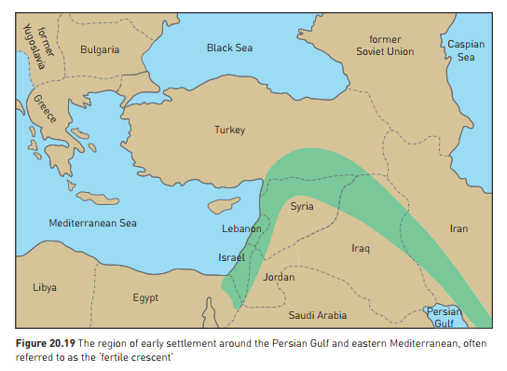

Slide 22



Cultural Evolution – Homo sapiens - The Modern Day
We are able to manipulate our environment to a high level
Travel
Medical technology – life expectancy
Complex society
Extremely fast acceleration in technology
Important to understand human origins
Helps understand modern humans
Lifestyle diseases often because our cultural evolution has outstripped our biological evolution
Still challenges to survival, some of our own making
Climate change an immediately pressing issue
May be able to evolve culturally so we are able to slow down or reverse the change we are making.

Slide 23


